Slide 1

Email Phishing
Asaf Galili - 315785006
Tal Sahar - 206955452

Slide 2
Research Question
How can advanced NLP and ML techniques improve the detection of phishing emails compared to traditional methods?

Slide 3

Problem Description
Phishing emails exploit human vulnerabilities, bypassing traditional filters.
Results in significant financial and data losses.
Growing sophistication of phishing attacks demands advanced detection techniques.

Slide 4

Related Work
Summarize key studies from the proposal (e.g., THEMIS model, Rabbi et al.'s ML framework, Salloum et al.'s review).
Highlight gaps, such as the lack of contextual embeddings like BERT.

Slide 5
Data Exploration

Slide 6

Dataset
Dataset Loading: The dataset was loaded from a CSV file named Phishing_Email.csv. Only the columns Email Text and Email Type were retained as they are directly relevant for analysis and classification.
Missing Data: Rows with missing values in either Email Text or Email Type were removed.
Invalid Rows: Only rows with valid Email Type labels (Safe Email or Phishing Email) were kept.

Slide 7
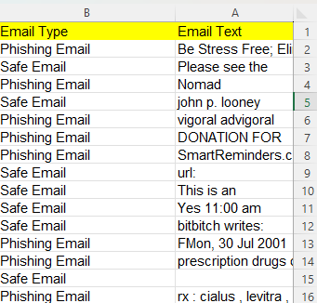
Our Dataset:
Consists on email messages labeled as 'Safe Email' or 'Phishing Email'.
Data is the email raw body text

Slide 8
Text Cleaning and Length Filtering
Text Length Filter: Rows with Email Text that were excessively short (<10 characters) or overly long (>5000 characters) were removed. This ensures that extreme outliers in text length do not distort the analysis.

Slide 9
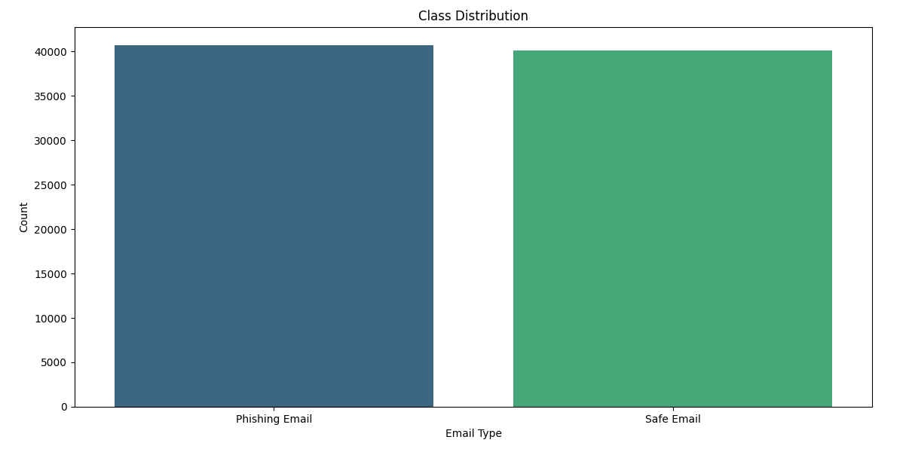
Class Distribution

Slide 10

Feature Engineering
Stop Word Ratio: Identified as the most significant feature, reflecting the proportion of stop words in email text, which varies between phishing and safe emails.
Average Word Length: Indicates the complexity of text; phishing emails often use simpler language.
Special Characters: Phishing emails frequently contain special characters (e.g., !, $) to attract attention or disguise malicious content.
Uppercase Letters: Excessive use of uppercase letters is often used in phishing emails to emphasize urgency or importance.
Digit Count: Phishing emails tend to include digits for codes, amounts, or other misleading information.
Text Length: Longer or shorter emails might indicate different strategies employed by phishing attempts.
Sentiment Polarity: Sentiment analysis reveals the tone of the email, often manipulative in phishing.
Word Count: The number of words in the email correlates with specific patterns in phishing emails.
Hyperlinks: The presence of hyperlinks is a strong indicator, as phishing emails often include links to fraudulent websites.
Spam Trigger Words: Common phishing words like "urgent," "win," or "free" contribute to this feature's significance.
Unique Domains: The number of unique domains in hyperlinks helps identify potentially malicious emails.
HTML Tags: While less significant, the use of HTML tags often indicates more sophisticated phishing attempts.

Slide 11
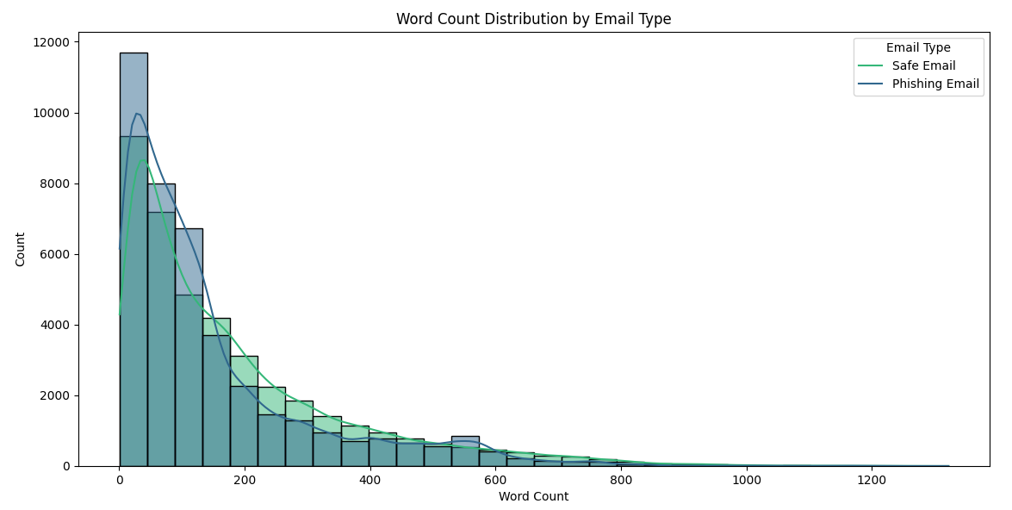
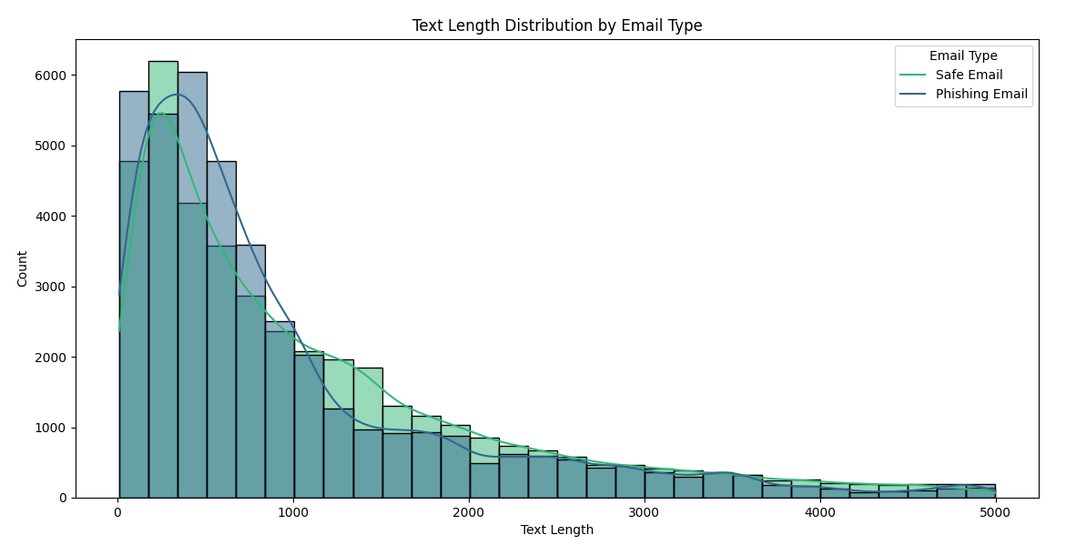
Represents the number of words in each email.​
Observation:​
Both email types tend to have a high frequency of shorter emails (low word count).​
Safe emails generally exhibit a broader spread toward higher word counts compared to phishing emails.
Represents the total character count of emails.
Observation:
Phishing emails and safe emails both peak at shorter lengths, but safe emails tend to have more instances of longer texts compared to phishing emails.
Key Insight:
Phishing emails are generally shorter in terms of word count and text length, which could be a distinguishing feature for detection models.

Slide 12
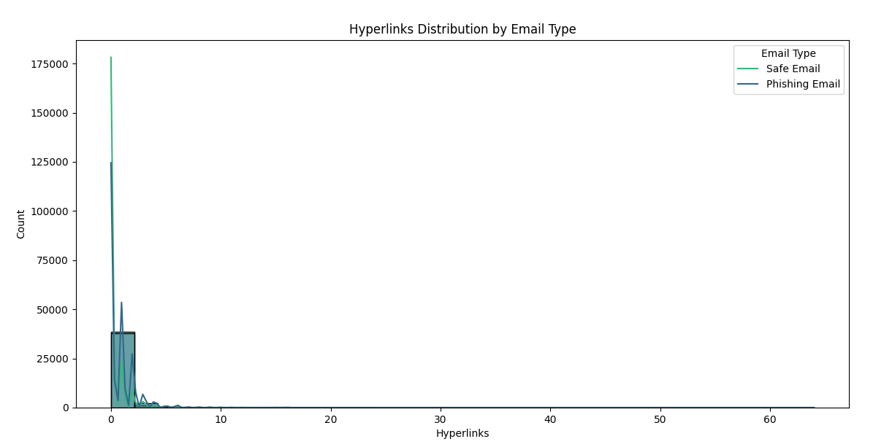
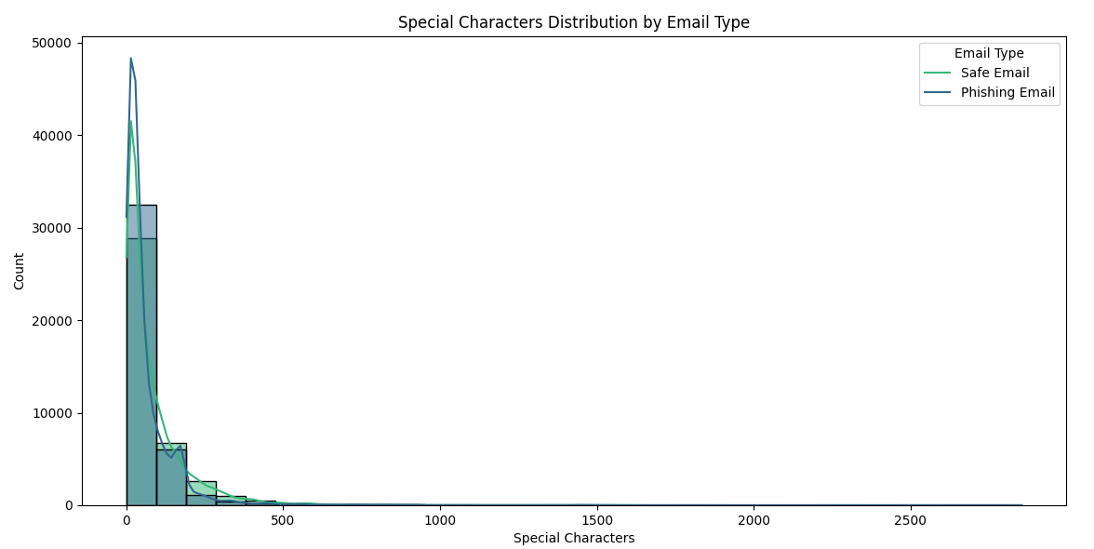
Observation:
Phishing emails generally have a higher frequency of hyperlinks, a common tactic to redirect victims to malicious sites.
Observation:
Special characters are more prevalent in phishing emails, likely used to bypass filters or mimic legitimate formatting
Key Insight:
While phishing emails often rely on fewer uppercase letters and digits, the distributions largely overlap, making these features supplementary rather than standalone indicators.

Slide 13
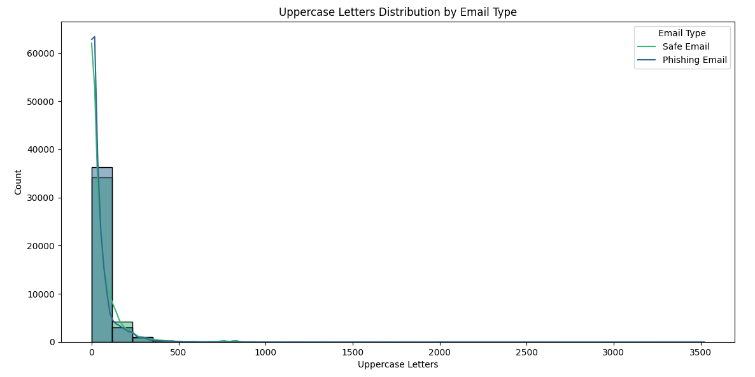
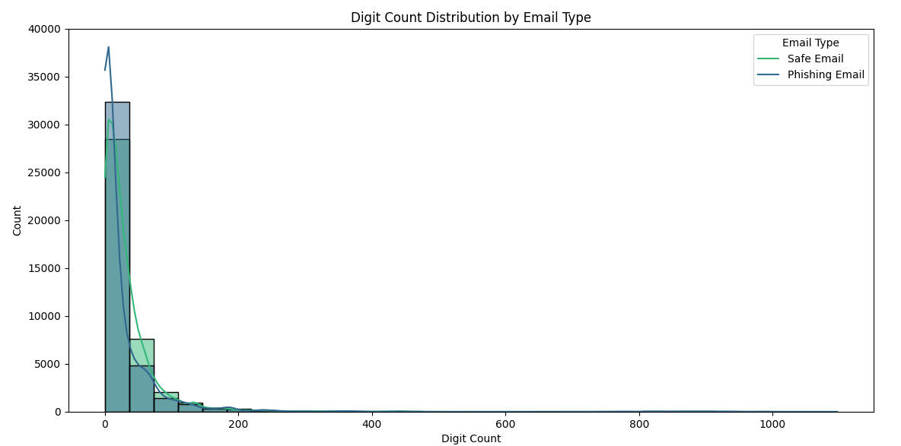
Observation:
Most emails (both safe and phishing) have a low count of uppercase letters.
Safe emails slightly dominate in higher uppercase letter counts, but this is rare
Observation:
Most emails have a low digit count.
Phishing emails seem slightly more concentrated in the lower digit range, but both email types overlap significantly.
Key Insight:
While phishing emails often rely on fewer uppercase letters and digits, the distributions largely overlap, making these features supplementary rather than standalone indicators.

Slide 14
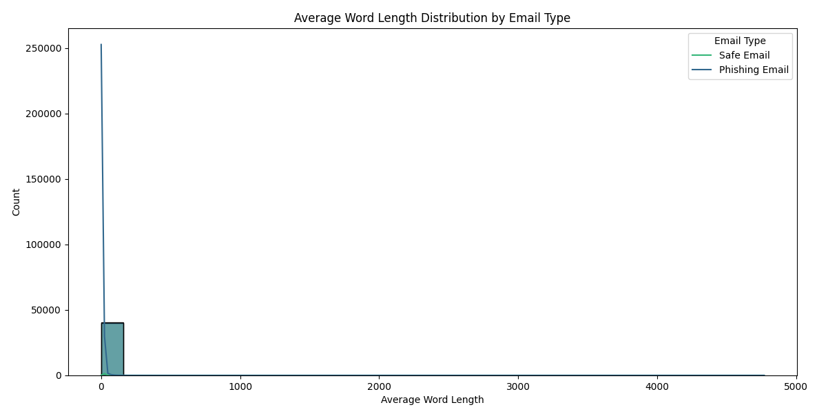
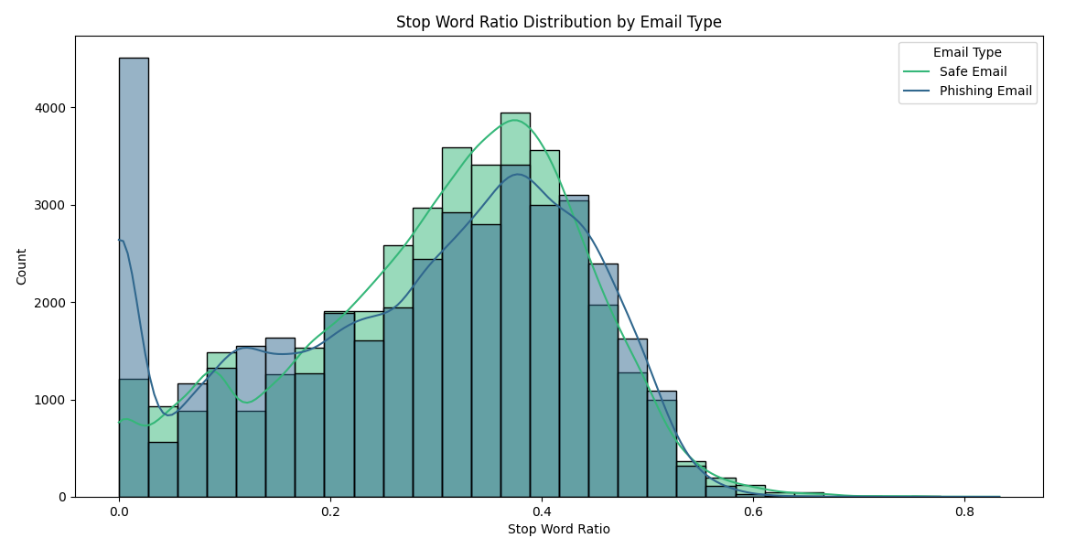
Observations:
Phishing emails tend to have shorter average word lengths compared to safe emails, indicating simpler language usage.
Observation:
Phishing emails generally exhibit a lower stop word ratio, as they often focus on critical, attention-grabbing words rather than forming complete sentences.
Key Insight:
The differences in average word length and stop word ratio suggest that phishing emails prioritize concise and impactful language to manipulate recipients, distinguishing them from safe emails.

Slide 15
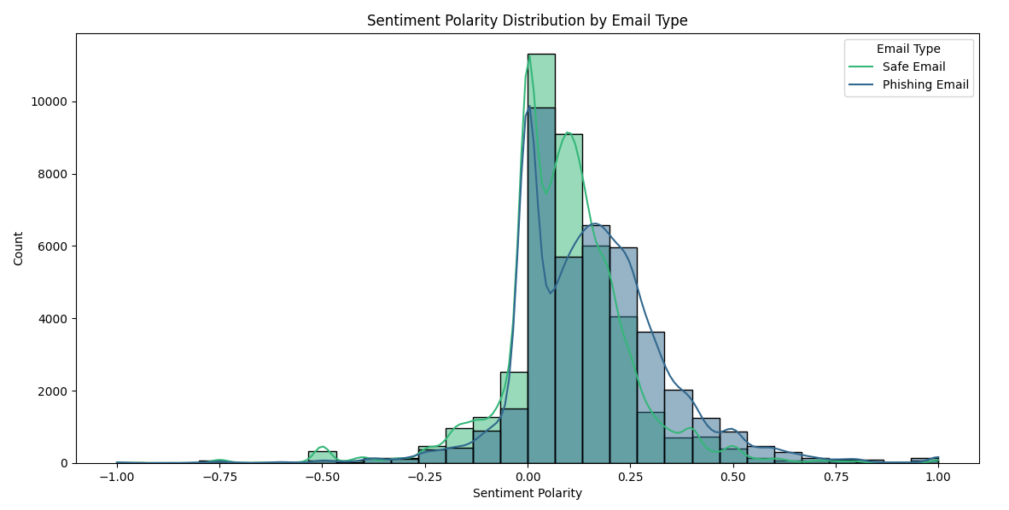
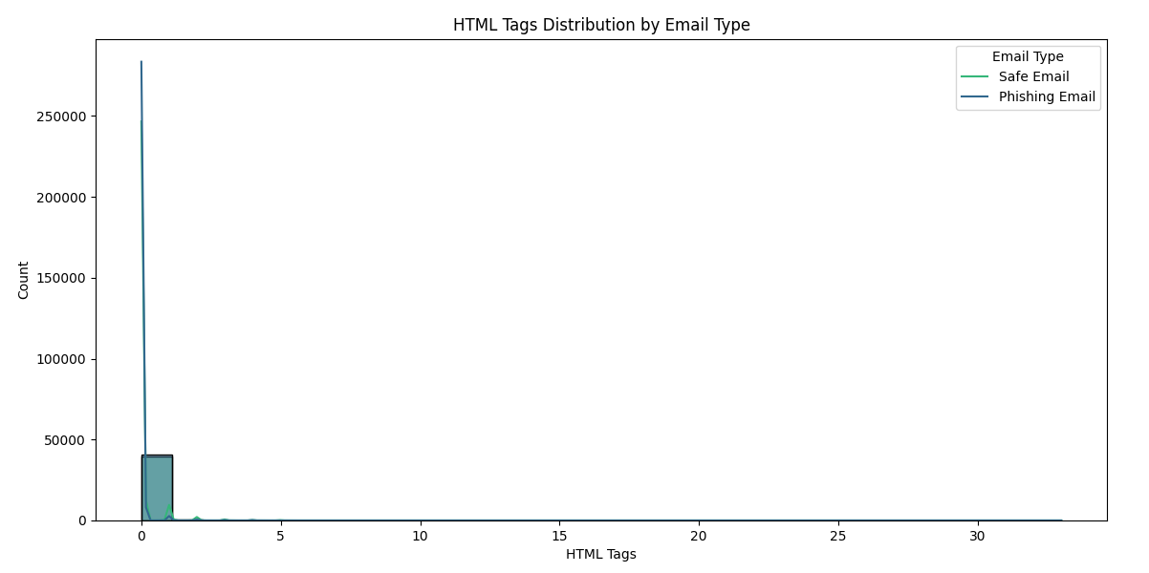
Observation:
Both safe and phishing emails cluster around neutral polarity (0).
Safe emails tend to lean slightly more towards positive polarity compared to phishing emails.
Phishing emails show a slightly higher count in the slightly negative polarity range.
Observation:
Both safe and phishing emails often have very few HTML tags (close to 0).
Safe emails exhibit slightly more occurrences of higher HTML tag counts compared to phishing emails.
Key Insight:
Sentiment polarity and HTML tag count alone are not strong discriminators, but their subtle differences contribute to the overall feature set for distinguishing phishing emails from safe ones.

Slide 16
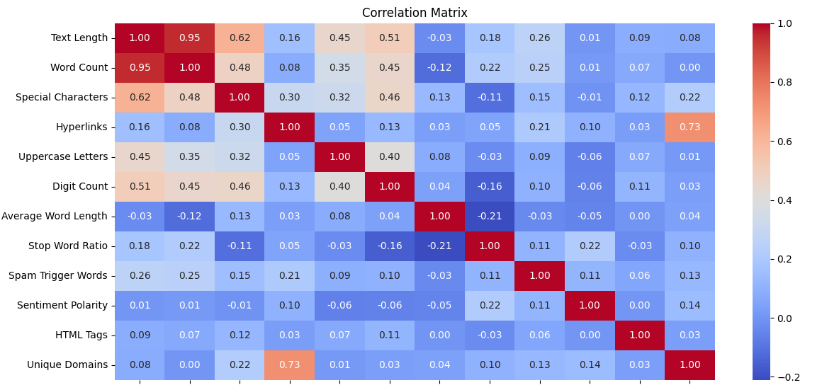
Features like Hyperlinks and Unique Domains show a unique pattern and might be particularly useful for phishing detection.
Features with low correlations (e.g., Sentiment Polarity) could still provide independent discriminatory power when combined with other features.

Slide 17
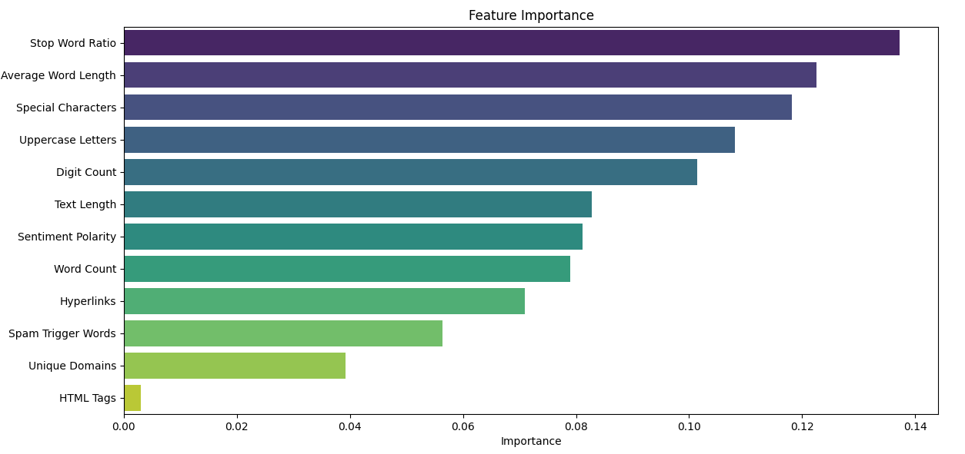

Slide 18

Proposed Solution
A Three-stage predictive approach:
Traditional Machine Learning: Random Forest Classifier using TF-IDF and additional handcrafted features.
Deep Learning: RoBERTa-based fine-tuning to leverage contextual word embeddings for better understanding of the email text.
Ensemble Model: Stacking ensemble that combines Random Forest features and RoBERTa embeddings, with a Logistic Regression meta-classifier for final predictions.

Slide 19

Advantages of the Proposed Method
Feature-Rich Approach:
Combines traditional NLP features with modern contextual embeddings for comprehensive text representation.
Transformer Fine-Tuning:
Leverages the state-of-the-art RoBERTa model for robust text classification.
Ensemble Model:
Integrates the strengths of traditional machine learning and deep learning for improved performance.

Slide 20

Work Flow
Email Classification for Phishing Detection:
Objective:
Develop a robust machine learning model to classify emails as Safe or Phishing.
Approach:
Data Preprocessing:
Text cleaning and feature engineering
Feature Extraction
TF-IDF Vectorization: Transform text into numerical vectors.
RoBERTa Embeddings: Leverage pre-trained transformer for contextual text representation.
Model Training
Random Forest Classifier: Trained on engineered features + TF-IDF.
RoBERTa Fine-Tuning: Pre-trained transformer fine-tuned on email data.
Ensemble Stacking:
Combines Random Forest outputs and RoBERTa embeddings.
Final classification using Logistic Regression.

Slide 21

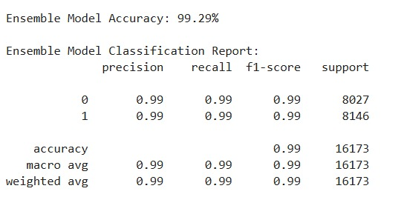
Our result:

Slide 22

Research conclusion:
By integrating state-of-the-art NLP techniques with ML models, our research bridges the gap between traditional phishing detection limitations and the complexities of modern phishing attacks.
The combination of contextual understanding from RoBERTa, feature engineering, and ensemble learning has enabled your solution to achieve high accuracy and adaptability, making it a robust tool for real-world phishing detection scenarios.

